Slide 1
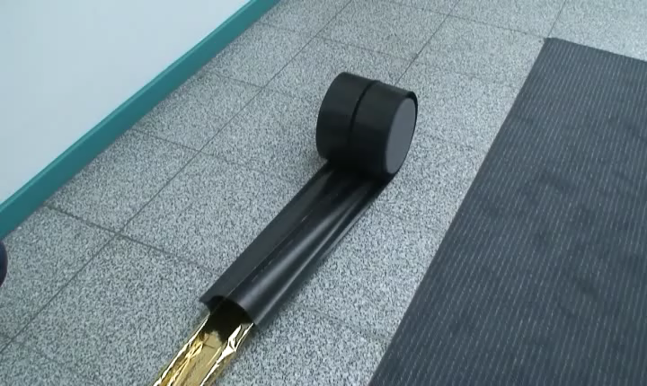
Deployment Boom
1

Slide 2

Three Membrane Mesh
2

Slide 3

Flat and Tubolar membrane structures
3

Slide 4
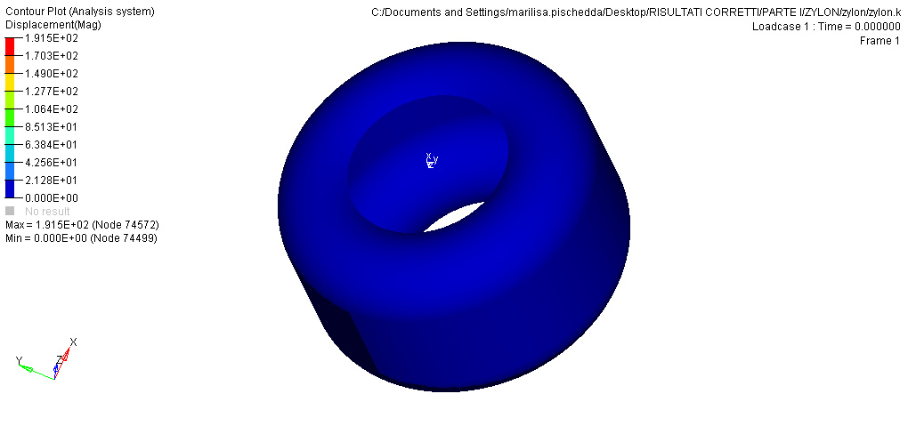
FE ANALYSY OF IMOD
(INFLATABLE MODULE)
4

Slide 5
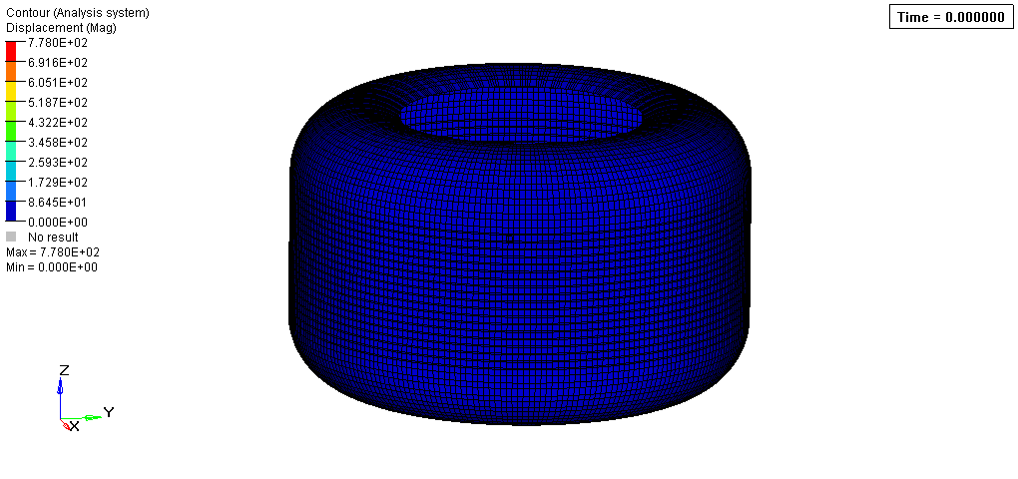
Folding Simulation
5

